Slide 1
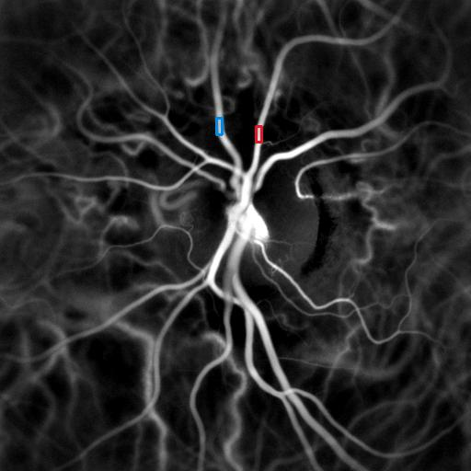
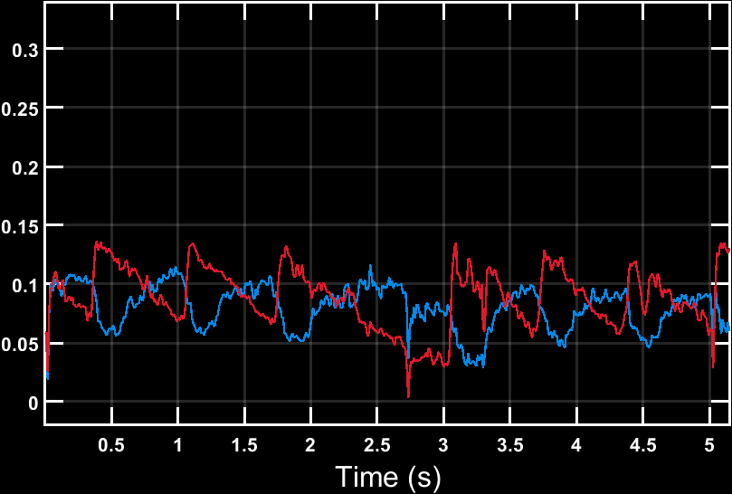
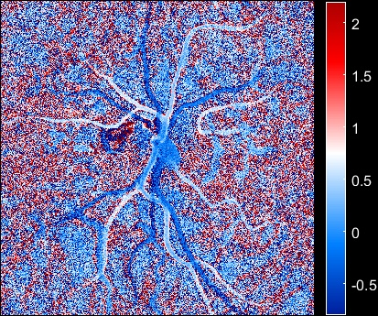
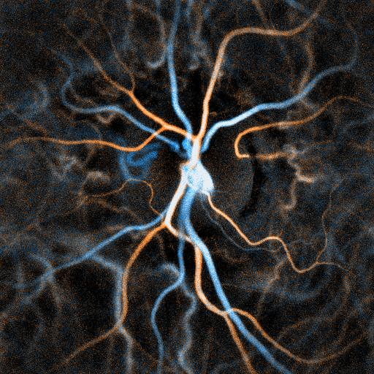
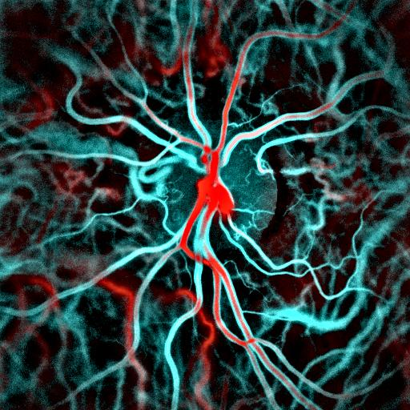


200110 GOM0180 OS
Power Doppler movie, 6-25 kHz
Power Doppler, 6-25 kHz
Power Doppler variations, 6-25 kHz
$$RI =$$
$$t_{SRT} =$$
$$t_{mean, A} =$$
$$t_{mean, V} =$$
$$t_{mean, A−V} =$$
0.45 0.05 s 0.32 s 0.38 s 0.06 s
50 kHz 2-6 kHz 6-25 kHz
$$f_{s} =$$
$$∆f_{low} =$$
$$∆f_{high}=$$
Resistivity, 6-25 kHz
Composite movie

